Slide 1
Wheezing, sneezing, coughing and squeaking
(respiratory distress in kids – a practical approach)
Parker EMS Education
February 9, 2022
Kristin M. Kim, MD, PhD
Pediatric Emergency Medicine, CHCO

Slide 2
No disclosures

Slide 3
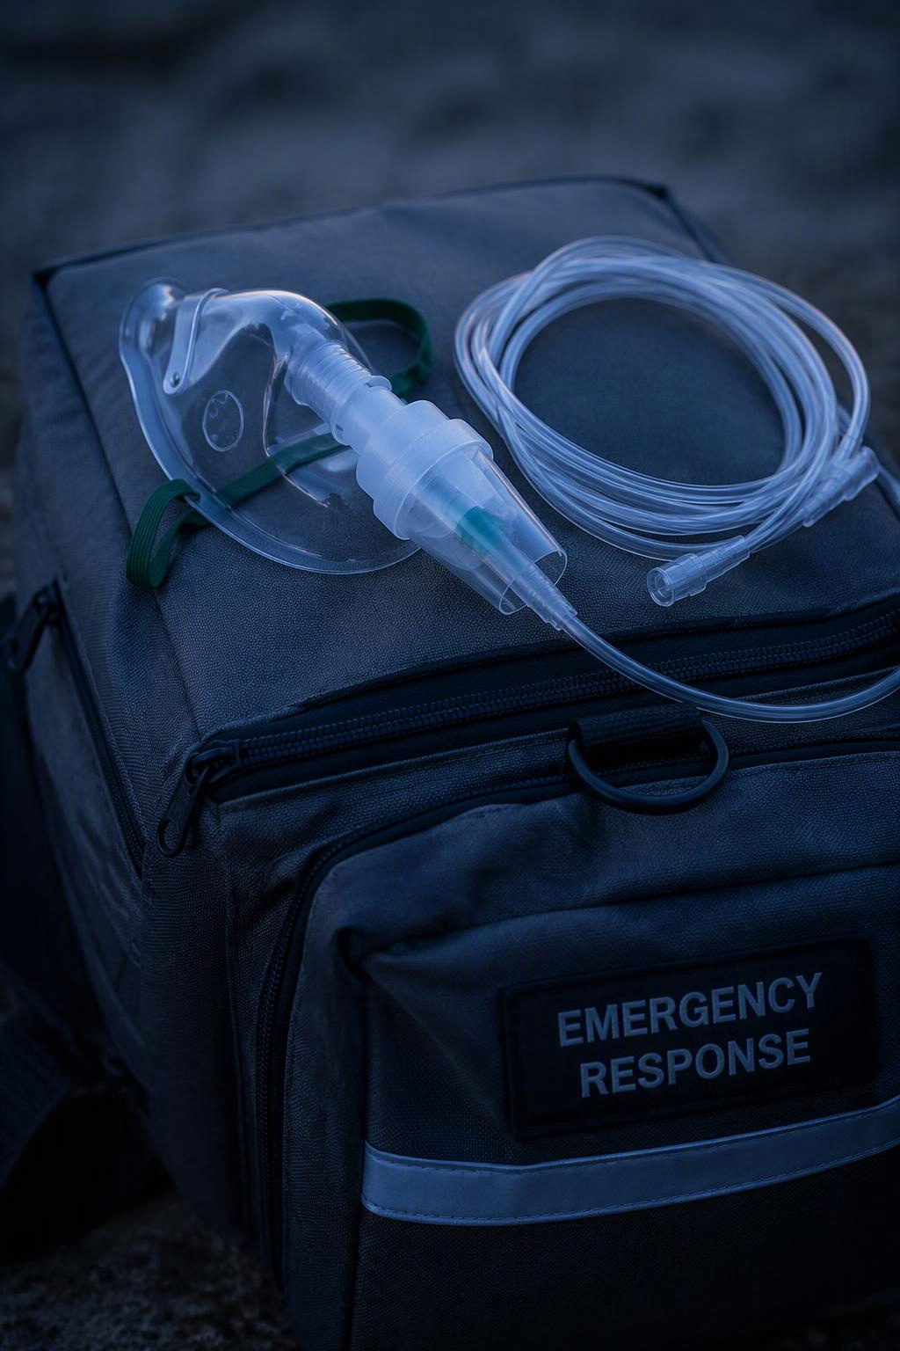
Case 1: Fred
Dispatch: 2 year old boy, mother reports difficulty breathing that worsened yesterday and continued overnight
On scene:
  Toddler aged child, pale appearing
  Not crying when you approach but appears ill
  Respiratory rate is fast
  You notice nasal flaring and tracheal tugging
What next?
Notes:
Basic approach to resp distress

Slide 4

Rapid Pediatric Assessment
Appearance
Work of breathing
Circulation / skin appearance

Slide 5
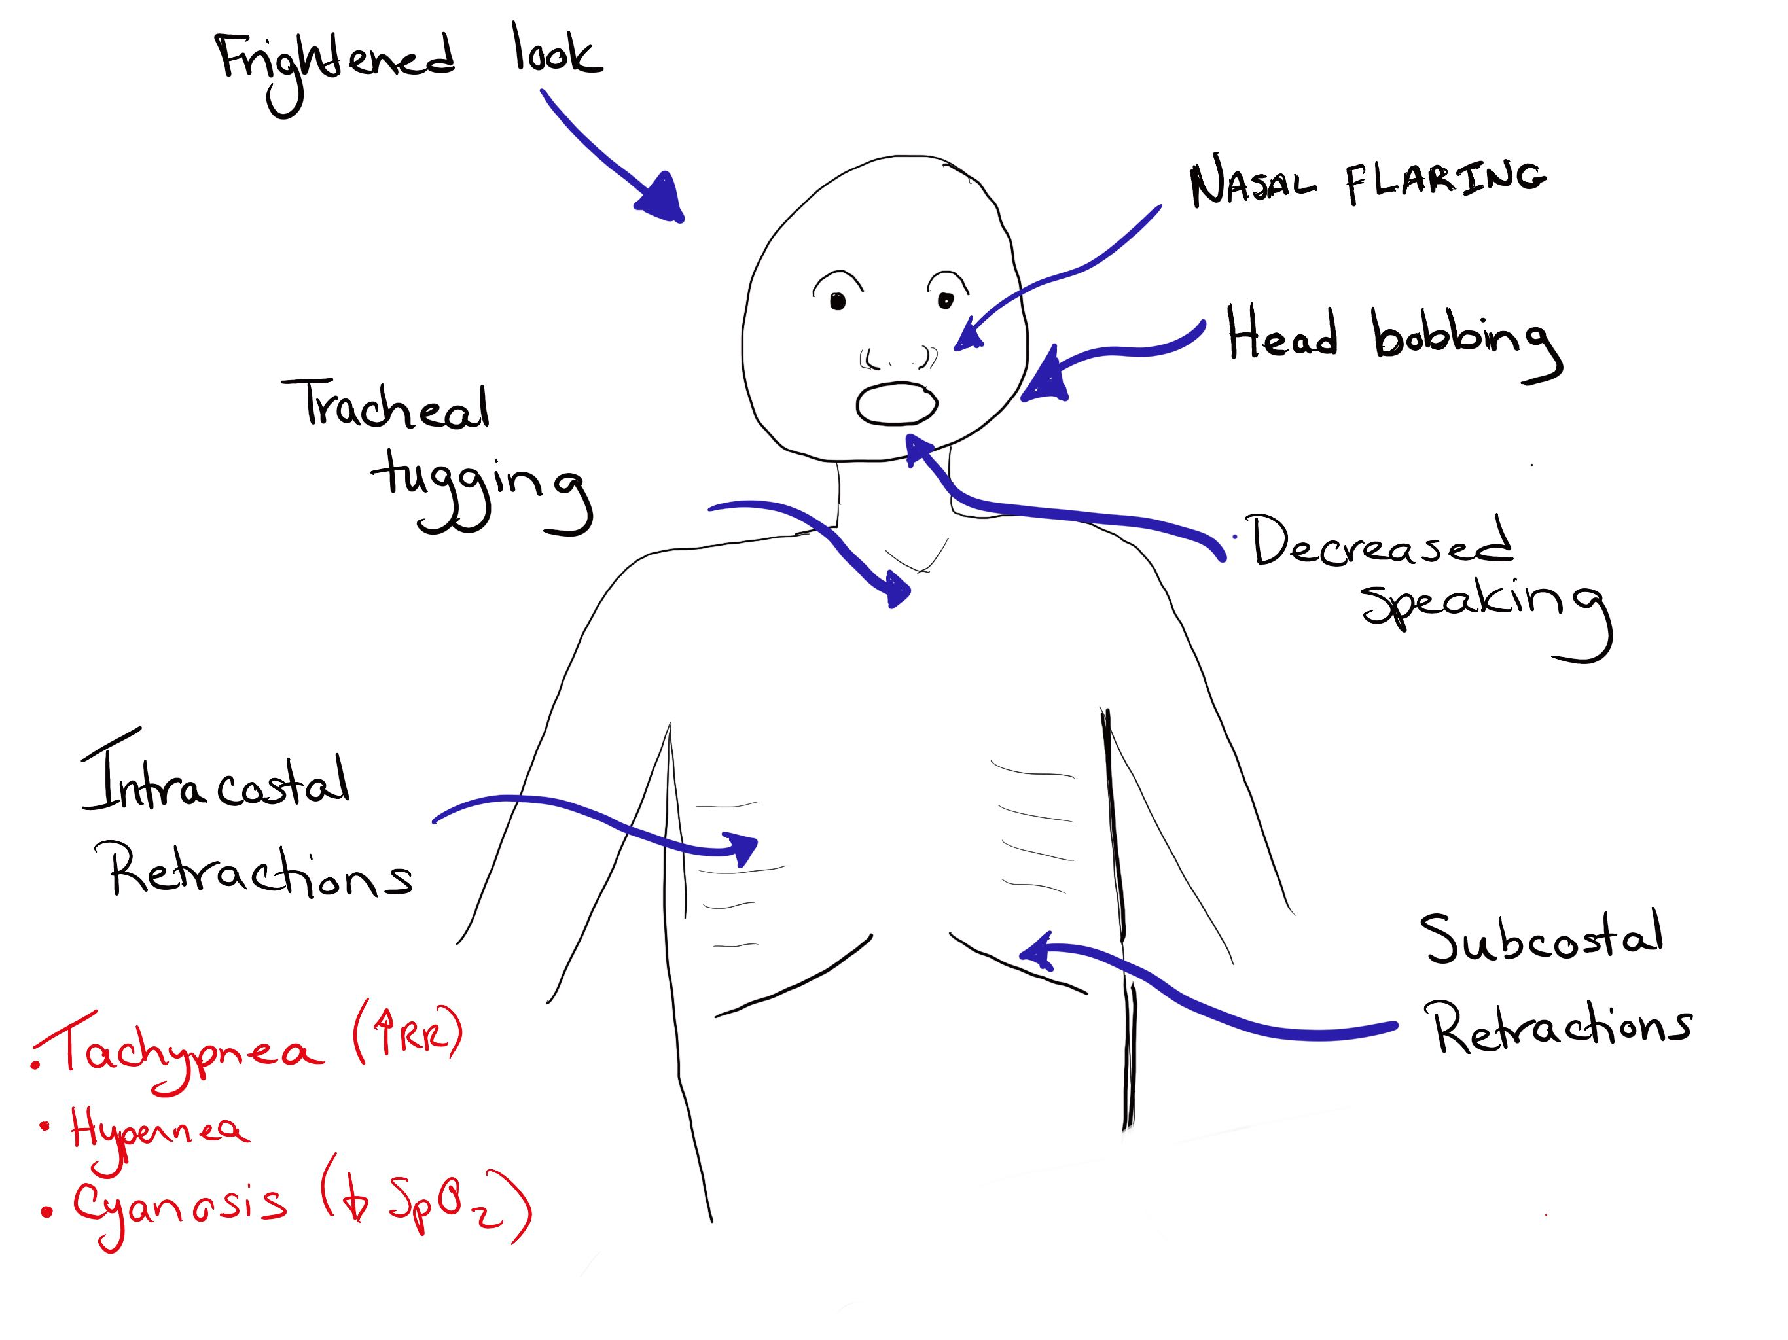
Respiratory distress :

Slide 6
Initial intervention in respiratory distress
Keep patient calm (in parent’s arms)
Good lung exam – listen for:
  How well is air moving?
  Rate?
  Any noises? – stridor (which phase?), wheezing? Crackles? Nothing?
Obtain vital signs – RR, HR, SpO2, temp (BP can wait here)
A quick history
  Preceding symptoms (URI?, playing with a toy?, eating? Hives? Fever?)
  Any other past medical history (tracheostomy, laryngomalacia, asthma?)
Provide respiratory support
  Supplemental O2
  Consider suctioning
  Medications?
  Positioning

Slide 7
Back to Fred
Appearance – looks sick
Breathing – breathing fast, + tracheal tugging with abdominal retractions, occasional inspiratory squeak
VS: RR 50, HR 140, pulse ox 95%
Quick History:
  Had URI symptoms x 1 day, much worse overnight and found in severe distress this morning
  Otherwise healthy, immunized pt
Diagnosis?
Notes:
Presumed dx = croup,

Slide 8
Back to Fred
Appearance – looks sick
Breathing – breathing fast, + tracheal tugging with abdominal retractions, occasional inspiratory squeak
VS: RR 50, HR 140, pulse ox 95%
Quick History:
  Had URI symptoms x 1 day, much worse overnight and found in severe distress this morning
  Otherwise healthy, immunized pt
Diagnosis?
Notes:
Presumed dx = croup,

Slide 9
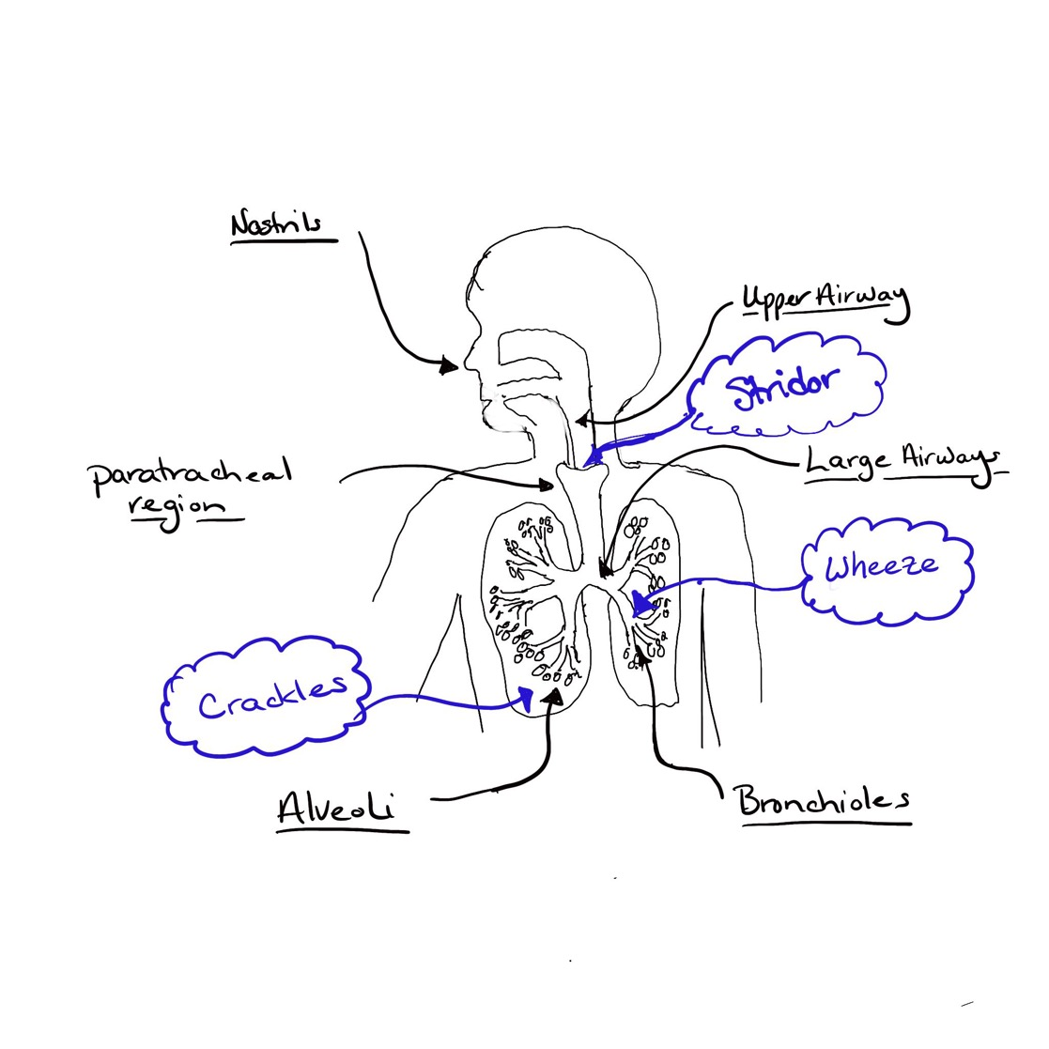
Locating the problem…..

Slide 10
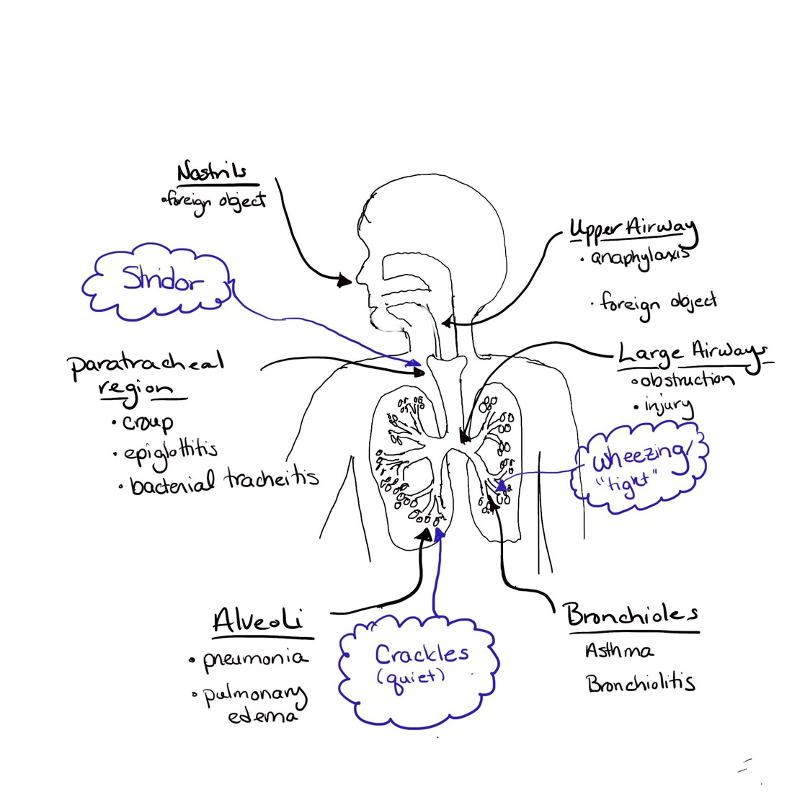
Differential Diagnosis by airway location

Slide 11
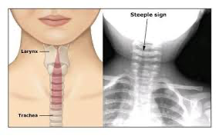
Croup - presentation
Viral infection of the upper airway – parainfluenza, RSV, COVID
Often but not always preceded by URI symptoms
Often rapid onset of distress
“croup always gets worse at night”
Typical symptoms:
  Barky cough (like a seal, not dog)
  Stridor (inspiratory squeaking noise)
  +/- fever
Inflammation of the upper airway / laryngiotracheitis

Slide 12
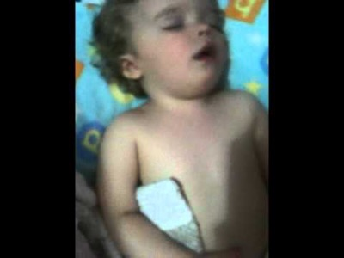

Slide 13
Croup - Treatment
Home remedies – cold air (works sometimes), warm shower (not really),
Treat the inflammation to open the upper airway
  Keep calm
  If stridor at rest or respiratory distress → Racemic Epinephrine
  Steroids eventually (onset of improvement is about 4-6 hours)
  CPAP/BiPAP
In the ED – racemic epi, heliox, decadron
This is not a happy intubation!

Slide 14
Other upper airway issues
Foreign body (consider airway maneuvers)
Epiglottitis
  This is a DIFFICULT airway
  Unvaccinated younger kids
  Keep them calm (no IV, minimal interventions)
Bacterial tracheitis – looks like croup but sicker…
Anaphylaxis –
  If suspected – consider IM epinephrine if respiratory distress
  Can have wheezing, stridor, decreased breath sounds
Can be at baseline

Slide 15
Back to Fred
You appropriately diagnose him with croup
As you head out to the ambulance – into the cold air – he gets a bit better
He still has some retractions and stridor so you appropriately give:
Racemic Epinephrine
ED arrival – He’s much better, gets his dose of decadron, we watch about 2-3 hours and he goes home

Slide 16
Things that scare me with croup:
No improvement with racemic epinephrine
  COVID croup seems more severe
High fever
Unimmunized kids with croup → much higher risk of epiglottitis or bacterial tracheitis
Abnormal airway at baseline
Any decreased O2 sat

Slide 17
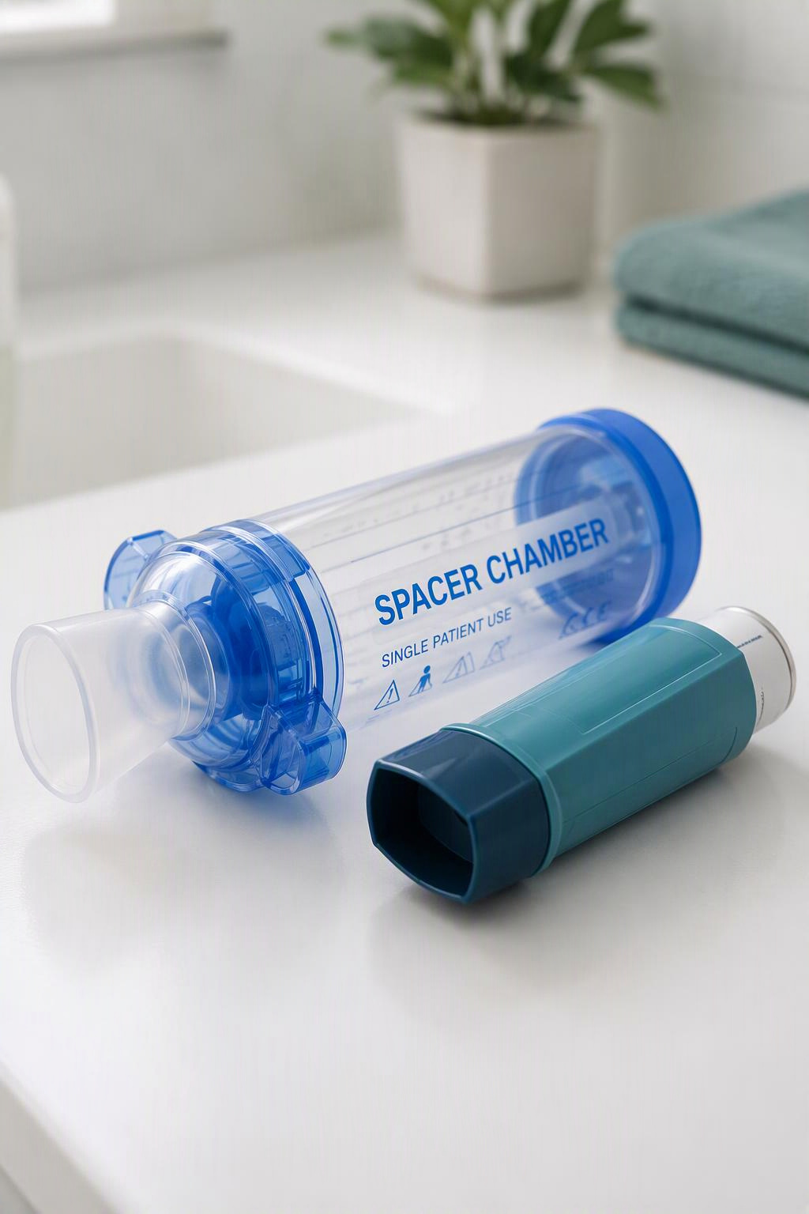
Maria
Dispatch: 12 year old girl – acute onset of difficulty breathing at school
On scene with teachers:
  ”She seemed okay this morning but had a bit of a cough, now she’s much worse and can’t speak well”
  12 yo girl – very quiet, looks very scared
  Respiratory rate looks a little fast
  She answers questions with 1-2 words only
  No recent fevers
On initial exam – very diminished breath sounds – maybe an occasional wheeze,
Working pretty hard – you notice that she seems to be using her shoulders to breathe…
What next?

Slide 18
Maria
Dispatch: 12 year old girl – acute onset of difficulty breathing at school
On scene with teachers:
  ”She seemed okay this morning but had a bit of a cough, now she’s much worse and can’t speak well”
  12 yo girl – very quiet, looks very scared
  Respiratory rate looks a little fast
  She answers questions with 1-2 words only
  No recent fevers
On initial exam – very diminished breath sounds – maybe an occasional wheeze,
Working pretty hard – you notice that she seems to be using her shoulders to breathe…
What next?

Slide 19
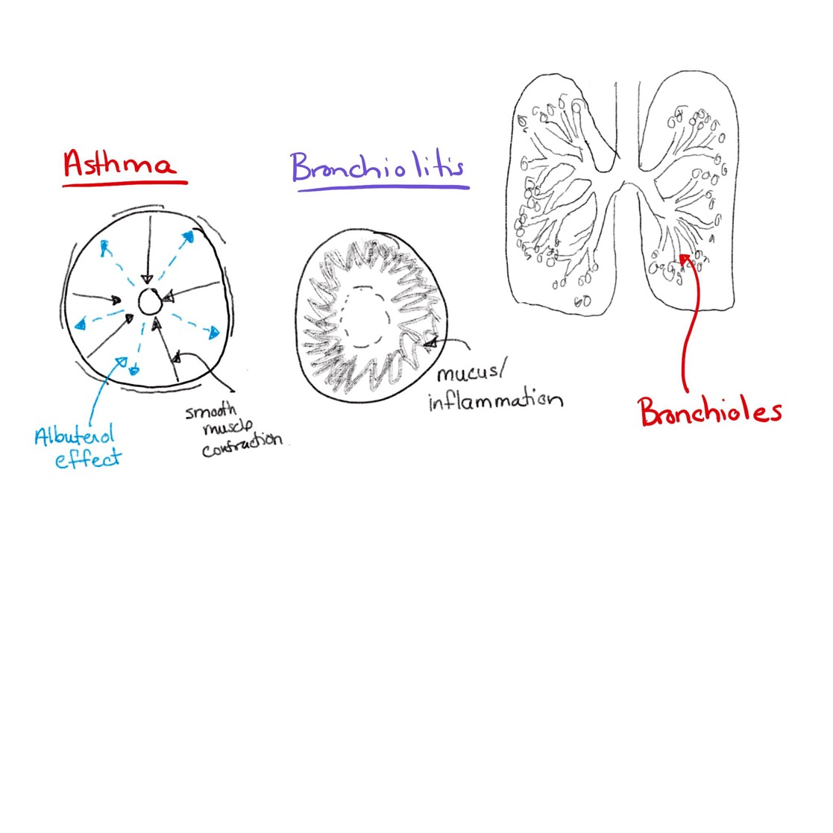
Differential Diagnosis by airway location
Notes:
Given her gradual worsening with cough earlier, now wheezing and distress I’m thinking asthma as most likely

Slide 20
Asthma - presentation
Acute bronchoconstriction of the small airways – smooth muscle contracts & inflammation of the small airways
Presentation
  Typically acute onset with early worsening
  Can wheeze, cough or just go silent
  Often history of prior wheeze/persistent cough or episodes of trouble breathing
  May have inciting trigger – URI, allergen, smoke
  Oxygenation usual adequate – if abnormal – this is severe asthma
  Tachypnea, retractions, wheezing
  Diminished lung sounds with increased expiratory phase

Slide 21
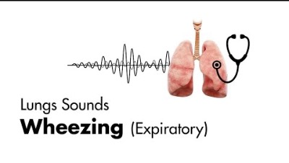
https://www.youtube.com/watch?v=T4qNgi4Vrvo

Slide 22
Asthma - treatment
Inhaled Albuterol (+/-) ipratroprium
  Relaxes the smooth muscle
  Works quickly (onset 1-2 minutes, peak 30 minutes)
Steroids
  Decrease the inflammation
  Work slowly (4-6 hours)
In the ED
  Magnesium (smooth muscle relaxant)
  Terbutaline/etc
  BiPAP – with continuous albuterol
  Avoid intubation!!!

Slide 23
Maria - continued
Hx – no formal asthma diagnosis, but she’s had wheezing in the past and needed to be in the hospital before. She started coughing last night and tried cough medicine without improvement
Exam
  RR – 30, HR 120, SpO2 96%
  Can’t hear lung sounds at all – faint expiratory noise
  Can only speak 1-2 words at a time
Intervention:
  Albuterol NMT (or MDI)
  Re-evaluation – now wheezing heard throughout
  Continue more Albuterol, transport
In the ED:
  She receives another 1 hour of continuous albuterol, decadron and improves
  Goes home with inhaler and education

Slide 24
Things that scare me with asthma
Acute onset of severe symptoms
Altered mental status
Teenagers with respiratory distress
Kids with “tight” variant asthma (no wheeze as warning signs)
Prior need for intubation or ICU
Current hypoxemia

Slide 25
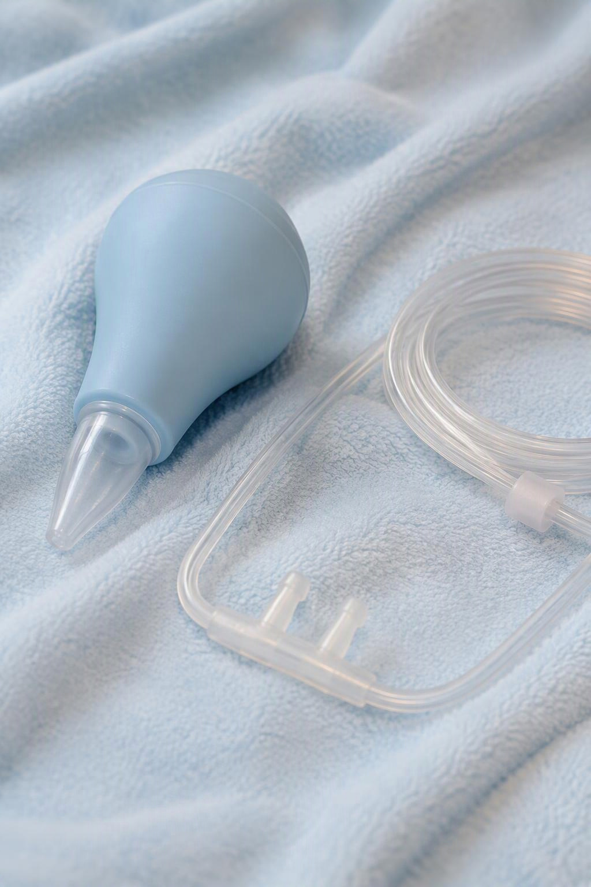
Rosie
Dispatch: 15 mo with worsening difficulty breathing – Mom says “she doesn’t look right and can’t breathe”
On scene:
  Appearance – limp but awake
  Breathing – Too fast, too hard
  Circulation – pale but not blue
History –
  2 days of URI symptoms, now seems to be breathing faster and harder,
  Decreased PO intake today
  Immunized
Exam
  Copious nasal discharge
  Lungs – RR 60, decreased air entry, + retractions (abdominal, tracheal, intracostal), wheezing and crackles diffusely
  Skin is well perfused with strong pulses
  VS - RR 60, HR 150, SpO2 – 86%

Slide 26
Rosie
Dispatch: 15 mo with worsening difficulty breathing – Mom says “he doesn’t look right and can’t breathe”
On scene:
  Appearance – limp but awake
  Breathing – Too fast, too hard
  Circulation – pale but not blue
History – 2 days of URI symptoms, now seems to be breathing faster and harder, hasn’t been eating well today. No PMHx
Exam –
  Copious nasal discharge
  Lungs – RR 60, decreased air entry, + retractions (abdominal, tracheal, intracostal), wheezing and crackles diffusely
  Skin is well perfused with strong pulses
  VS - RR 60, HR 150, SpO2 – 86%

Slide 27
Differential Diagnosis by airway location

Slide 28
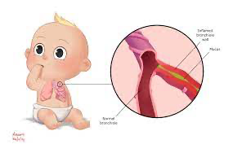
Bronchiolitis
Viral infection of the upper and lower airways
  – RSV, Parainfluenza, Covid
  Copious mucus production with some bronchospasm
  Initial symptoms - URI (cough, congestion, rhinorrhea +/- fever)
  Symptoms worsens over 4-6 days then improve
Presentation
  Lots of mucus
  Poor feeding
  Changing lung exam with crackles, wheezing, decreased breath sounds
  Respiratory distress with increased WOB – retractions, nasal flaring
  Hypoxemia
  Dehydration

Slide 29
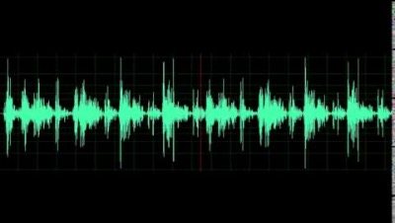
Bronchiolitis (rice krispies, washing machine, coarse crackles, variable exam)

Slide 30
Bronchiolitis - treatment
REST is BEST
Supportive care only
  Nasal suctioning (no evidence for deep suctioning)
  Control fevers
  Supplemental O2 if needed
  Non-invasive positive pressure ventilation
  IVF if not drinking well
Albuterol doesn’t help (most of the time)
Racemic epinephrine doesn’t help
X-rays don’t really help
Steroids don’t help

Slide 31
Rosie - continued
You quickly suction her nose – get lots out
She still has increased RR but looks more comfortable
O2 placed (NC at 2-3 L) – improved O2 sats
You treat her fever with ibuprofen and give her a bottle
Transport to the ED
In the ED – we continue O2, suction again and admit for O2. She spends 2-3 days in the hospital and recovers well

Slide 32
Things that scare me with bronchiolitis:
Altered mental status
Hypoxemia not improving with O2
Need for increasing support over several hours
”Is this bronchiolitis or something else?”

Slide 33

Matias
Dispatch: 8 yo with worsening illness, can’t breathe
On scene –
  Appearance – Ill appearing but awake
  Breathing – Slightly increased rate with apparent dyspnea
  Circulation – Pale
History
  Had URI symptoms for the past 3-4 days, now with high fever and worsening cough over past day. Now having c/o dyspnea
  No PMHx
Exam
  RR 30, HR 120, SpO2 85%
  Lungs – no wheezing, no stridor, few fine crackles – R side lower lobe

Slide 34
Matias
Dispatch: 8 yo with worsening illness, can’t breathe
On scene –
  Appearance – Ill appearing but awake
  Breathing – Slightly increased rate with apparent dyspnea
  Circulation – Pale
History
  Had URI symptoms for the past 3-4 days, now with high fever and worsening cough over past day. Now having c/o dyspnea
  No PMHx
Exam
  RR 30, HR 120, SpO2 85%
  Lungs – no wheezing, no stridor, few fine crackles – R side lower lobe

Slide 35
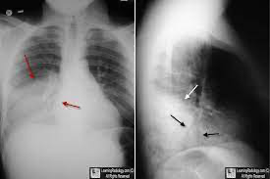
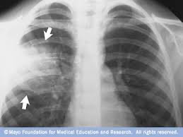
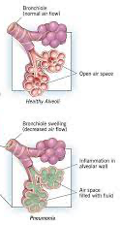
Differential Diagnosis by airway location

Slide 36
Pneumonia
Viral/bacterial infection of the airspaces / alveoli
Presentation
  Fever, cough, dyspnea
  Often preceded by URI
  Lung sounds – fine crackles, focal area of decreased sounds
  May have tachypnea, retractions but might not
  Hypoxemia
Diagnosis
  Clinical exam
  CXR
Can be complicated by empyema (fluid/pus in the pleural space)

Slide 37
Pneumonia - treatment
O2 support – supplementation
Respiratory support (HHFNC, BiPAP, intubation)
Antibiotics if bacterial
Time

Slide 38
Matias - continued
You astutely recognize need for supplemental O2 – improved with NC at 4L
He still looks ill and you have a long transport time (1 hour)
  Consider IVF bolus
  Consider glucose check
  Treat fever
ED arrival – Improved after a bit of fluid but still needs O2, CXR shows a RLL pneumonia – treated with amoxicillin and admission

Slide 39
Things that worry me about pneumonia
Multiple lobes involved
Worsening despite treatment
Severe O2 need or respiratory distress
Signs of sepsis
Unimmunized kids

Slide 40
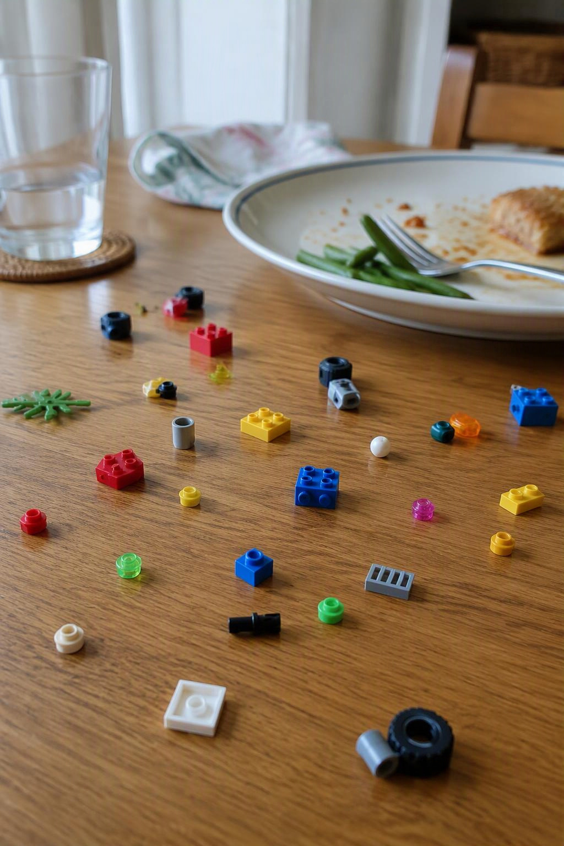
Diego
Dispatch: 3 yo boy, apparent choking episode now with difficulty breathing
On scene:
  Appearance – awake, appears frightened
  Breathing – increased WOB, intermittent stridor
  Circulation – well perfused
History:
  Was eating and playing with legos at the table – sudden onset of difficulty breathing, appeared to be choking
  Still having difficulty
Exam:
  Respiratory distress – rate 30, poor lung sounds

Slide 41
Diego
Dispatch: 3 yo boy, apparent choking episode now with difficulty breathing
On scene:
  Appearance – awake, appears frightened
  Breathing – increased WOB, intermittent stridor
  Circulation – well perfused
History:
  Was eating and playing with legos at the table – sudden onset of difficulty breathing, appeared to be choking
  Still having difficulty
Exam:
  Respiratory distress – rate 30, poor lung sounds

Slide 42
Differential Diagnosis by airway location

Slide 43
Airway foreign objects
Can partially or completely obstruct the airway
Food, toys
Might not have any history of ingestion/aspiration
Go back to the basics:
  Heimlich / abdominal thrusts / back blows
  If unresponsive and not working – DL to visualize
    Pull it out
    Push it down
    Try to intubate around it…
    Needle cricothyrotomy

Slide 44
Back to Diego:
You quickly recognize the need for back blows/abdominal thrusts
After 2 back blows – out pops a lego
Much improved
Transport given continued complaints of pain and coughing
Bronchoscopy much later pulls out another tiny Lego from the R mainstem…

Slide 45
Difficulty breathing that isn’t respiratory:
DKA
Kusmaul breathing
Deep, slow breathing
Hx of DM, weight loss, thirst
Toxins
Opioids – slow shallow breathing
Aspirin
Cardiomyopathy/myocarditis
Cough, wheeze, dyspnea
Clear lungs
Abdominal pain or infection
Tender abdomen
Distended abdomen
Clear lung sounds
Sepsis
Fever
Ill appearing

Slide 46
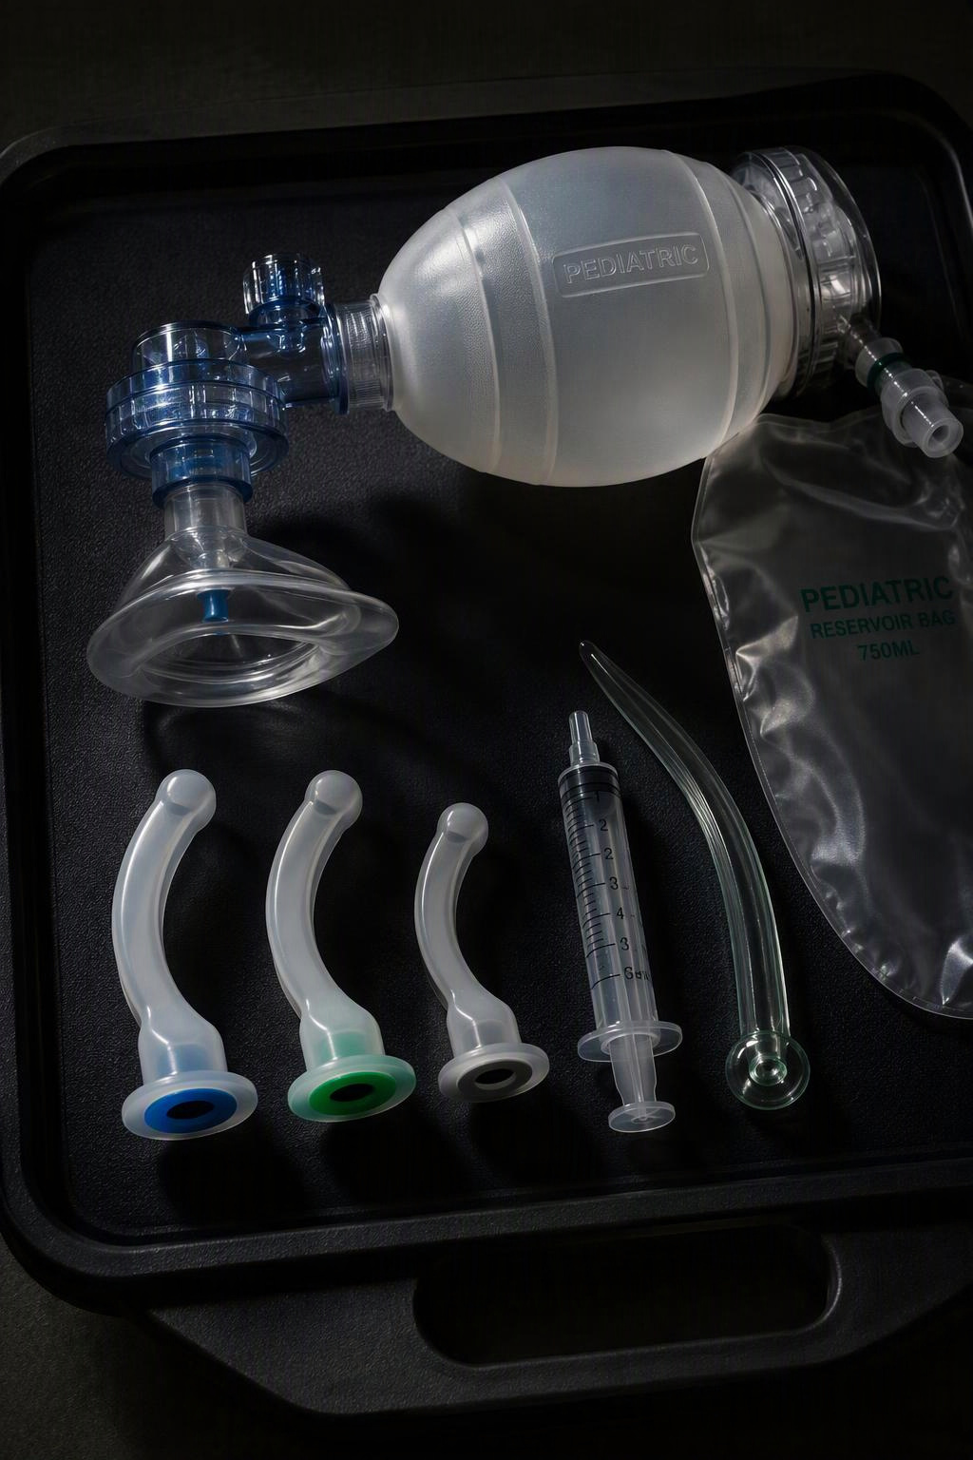
Jennifer
Dispatch: 3 yo girl with severe respiratory distress at home
On scene –
  Appearance – limp, not moving
  Breathing – Occasional gasping respirations
  Circulation – cyanotic, pulses adequate HR 90, SpO2 70% on RA
Now what?

Slide 47
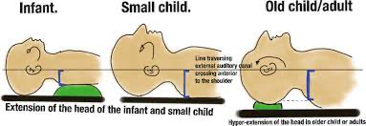
Respiratory failure – Airway Positioning
  Jaw thrust
  Towel roll
  Consider FB

Slide 48
Respiratory Failure: Breathing
Add O2
Consider positive pressure
BVM ventilation
Intubation?

Slide 49

To Intubate… or Not to Intubate…?
If ventilation and oxygenation is adequate with BVM:
  Don’t intubate
  Prepare just in case…
  Consider an NG to suction for gastric decompression
  Multiple studies show no benefit for intubation in the field (some show harm)
Effective BVM ventilation saves lives….
Notes:
Tell actual outcome here.

Slide 50
If you remember just a few things:
Stridor
  think croup, anaphylaxis, FB
  Racemic Epi
Wheezing (or very diminished lung sounds)
  Think asthma, bronchiolitis
  If Asthma → Albuterol
  If bronchiolitis → suctioning
  Not sure? Trial and re-evaluate
Quiet hypoxemia – with lung sounds
  Think pneumonia
  Supplement with O2
Not all that breathes fast is respiratory
If you can’t hear breath sounds – there might not be any
Effective BVM ventilation saves lives.

Slide 51
Thank you
Questions? Comments?
Kristin.kim@childrenscolorado.org

